Slide 1
Data Types and Representation

Slide 2
Data
Refers to the symbols that represent people, events, things, and ideas
It can be a name, a number, the colors in a photograph, or the notes in a musical composition

Slide 3
Data Types
A data type, in programming, is a classification that specifies which type of value a variable has and what type of mathematical, relational or logical operations can be applied to it without causing an error. A string, for example, is a data type that is used to classify text and an integer is a data type used to classify whole numbers.
Data Type | Used for | Example
String | Alphanumeric characters | hello world, Alice etc.
Integer | Whole numbers | 7, 12, 999
Float (floating point) | Number with a decimal point | 3.15, 9.06, 00.13
Character | Encoding text numerically | a, b, x etc.
Boolean | Representing logical values | TRUE, FALSE

Slide 4
Data Representation
Refers to the form in which data is stored, processed, and transmitted
Devices such as Computers, Smartphones, and iPods store data in digital formats that can be handled by electronic circuitry
Computers run on electricity – which can be either on or off
The two-state situation allows computers to use the binary system to represent data and programs

Slide 5
Binary System
All data and program instructions that go into the computer are represented in terms of binary numbers
Binary system has only two digits: 0 and 1
Example:
When key “G” is pressed on the computer keyboard, the character is automatically converted into the series of electronic impulses that the computer can recognize

Slide 6
Digitization
The process of converting manual data, such as text, numbers, photo, or music into digital data so that it can be used by electronic devices like computers, smartphones, etc.

Slide 7
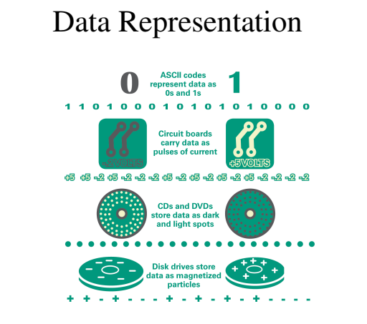

Slide 8
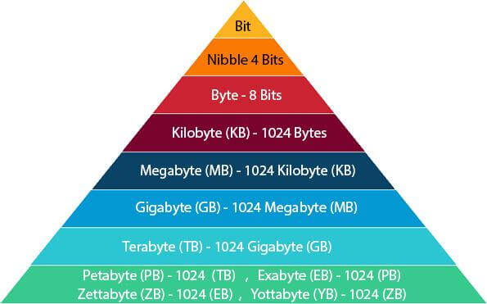
Measuring Capacity
How many representations of 0s and 1s can be held in a computer or a storage device such as a hard disk?
Capacity is denoted by bits and bytes and multiples thereof—kilobytes, megabytes, gigabytes, and so on

Slide 9
Binary Coding Schemes

Slide 10
Binary Coding Schemes
Letters, numbers, and special characters are represented within a computer system by means of binary coding schemes
These schemes are different arrangement of off/on or 0s and 1s in such a way that they represent characters, digits, or other values

Slide 11
ASCII
Stands for American Standard Code for Information Interchange
Pronounced as “ask-ee”
It is the binary code most widely used on microcomputers in English and Western European languages

Slide 12
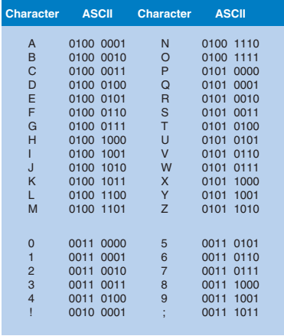
Extended ASCII
ASCII was originally developed for basic computers and uses a 7-bit code
As more computers began to work with 8-bit groups of data, ASCII was written as 8 bits (Extended ASCII)
Using eight bits instead of seven bits allows Extended ASCII to provide codes for 256 characters (2^8), where 1 bit is reserved and 255 available.
Includes such characters as math symbols and Greek letters
ASCII’s 256 characters, however, are not enough to handle such languages as Chinese and Japanese, with their thousands of characters

Slide 13
Unicode
It was developed in the early 1990s
Unicode uses 2 bytes for each character with default encoding scheme of 16-bits, hence it can handle 65,536 character combinations (2^16).
Hence it allows almost all the written languages of the world to be represented using a single character set

Slide 14
Other Coding Schemes
UTF – 8 (Unicode Transformation Format – 8 bit)
EBCDIC – Extended Binary Coded Decimal Interchange Code)
Used with IBM or IBM compatible mainframe computers

Slide 15
Text Document
Plain, unformatted text is sometimes called ASCII text and is stored in a text file with a name ending in .txt.
In Windows, these files are labeled as “Text Document” while on Apple devices these files are labeled “Plain Text.”
ASCII text files contain no formatting
To create documents with styles and formats, formatting codes have to be embedded in the text

Slide 16
Formatted Text Document
Microsoft Word produces formatted text and creates documents in DOCX format
Apple Pages produces documents in PAGES format
Adobe Acrobat produces documents in PDF format
HTML markup language used for Web pages produces documents in HTML format

